Slide 1


Insert relevant picture related to the topic
ALGORITHMS AND DATA STRUCTURES
TEB1113/TFB2023
WEEK II
ARRAYS (2D)
FARAHIDA HANIM BT MAUSOR - DR (FSMC/UTP)
BACHELOR OF XXXXXX
DEPARTMENT OF COMPUTING
FACULTY OF SCIENCE, MANAGEMENT & COMPUTING
© 2026 INSTITUTE OF TECHNOLOGY PETRONAS SDN BHD
All rights reserved. No part of this document may be reproduced, stored in a retrieval system or transmitted in any form or by any means (electronic, mechanical, photocopying, recording or otherwise) without the permission of the copyright owner.

Slide 2
RECAP FROM PREVIOUS LECTURE
Data structures organize data in memory.
Primitive data types store simple values.
Non-primitive structures organize multiple values or relationships.
C++ struct can group different data types into one record.
Notes:
Learning Outcomes Slide
Note:
Include 2–4 lecture-level learning outcomes
Use measurable action verbs
Map explicitly to Course Learning Outcomes (CLOs)

Slide 3
LEARNING OUTCOMES
Define arrays and explain their contiguous memory layout.
Access array elements using index positions and address calculation.
Implement 1D and 2D arrays in C++.
Solve basic matrix-based problems using nested loops.
Notes:
Learning Outcomes Slide
Note:
Include 2–4 lecture-level learning outcomes
Use measurable action verbs
Map explicitly to Course Learning Outcomes (CLOs)

Slide 4
TOPICS
Array Basics
Memory Layout and Indexing
Why Arrays Are Useful
4. 2D Arrays and Matrices
5. C++ Lab Practice
Notes:
Learning Outcomes Slide
Note:
Include 2–4 lecture-level learning outcomes
Use measurable action verbs
Map explicitly to Course Learning Outcomes (CLOs)

Slide 5
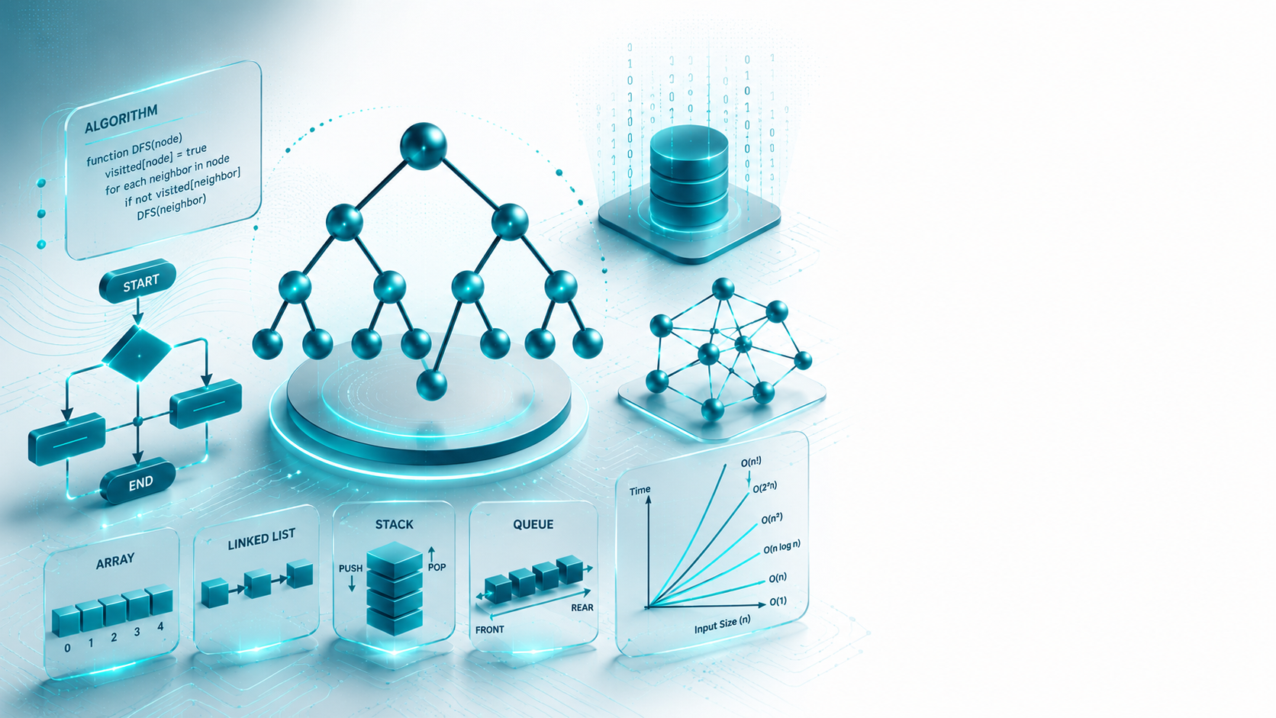
ARRAYS (2D)
Introduction

Slide 6
INTRODUCTION
1.1. WHAT IS AN ARRAY?
Arrays are defined as a collection of similar data items of the same type.
Data items in an array are stored at contiguous memory locations.
Data elements can be randomly accessed by using their index number
Store → Access → Process
Notes:
Engagement and Activity Slides
Note:
Include at least one engagement element where appropriate:
Think–Pair–Share
Mini task
Poll or reflection question
Suggested duration: 3–5 minutes
Activities shall align with learning outcomes

Slide 7
INTRODUCTION
1.2. PROPERTIES OF AN ARRAY
Each element in an array is of the same data type and carries the same size.
Elements in the array are stored at contiguous memory locations from with the first element stored at the smallest memory location.
Elements of the array can be randomly accessed since we can calculate the address of each element of the array with the given base address and the size of the data element.
Notes:
Engagement and Activity Slides
Note:
Include at least one engagement element where appropriate:
Think–Pair–Share
Mini task
Poll or reflection question
Suggested duration: 3–5 minutes
Activities shall align with learning outcomes

Slide 8
INTRODUCTION
1.3. 1D vs 2D ARRAYS
Index: 0 1 2 3 4
Value: [12] [25] [18] [30] [22]
A 2D array stores data in rows and columns. It is commonly used for tables, grids, and matrices.
[1] [2] [3] [4] [5] [6] [7] [8] [9]
COLUMNS
ROWS
Notes:
Engagement and Activity Slides
Note:
Include at least one engagement element where appropriate:
Think–Pair–Share
Mini task
Poll or reflection question
Suggested duration: 3–5 minutes
Activities shall align with learning outcomes

Slide 9
INTRODUCTION
1.4. WHY ARRAYS ARE USEFUL?
Sorting and searching for a value in an array are easier.
Arrays are best for processing multiple values quickly and easily
Arrays are good for storing multiple values in a single variable
Notes:
Engagement and Activity Slides
Note:
Include at least one engagement element where appropriate:
Think–Pair–Share
Mini task
Poll or reflection question
Suggested duration: 3–5 minutes
Activities shall align with learning outcomes

Slide 10
SUMMARY
TODAY’S KEY TAKEAWAYS:
Arrays store same-type elements in contiguous memory.
Indexing allows direct access to elements.
Address calculation depends on base address and element size.
2D arrays represent data in rows and columns.
Nested loops are used to process matrix-style data.
Notes:
Engagement and Activity Slides
Note:
Include at least one engagement element where appropriate:
Think–Pair–Share
Mini task
Poll or reflection question
Suggested duration: 3–5 minutes
Activities shall align with learning outcomes

Slide 11
LAB TASK
CREATE A C++ PROGRAM USING STRUCT AND ARRAYS
Your program should:
Store at least 5 student records.
Include student ID, name, age, course.
Display all records.
Search for a student by ID.
Update one student record.
Notes:
Engagement and Activity Slides
Note:
Include at least one engagement element where appropriate:
Think–Pair–Share
Mini task
Poll or reflection question
Suggested duration: 3–5 minutes
Activities shall align with learning outcomes

Slide 12
LAB TASK
Implementation of multi-dimensional arrays and problems related to them, like matrix multiplication, etc.
https://www.geeksforgeeks.org/top-50-matrix-grid-coding-problems-for-interviews/

Slide 13

THANK YOU
FARAHIDA HANIM BT MAUSOR - DR (FSMC/UTP)
DEPARTMENT OF COMPUTING
farahida.mausor@utp.edu.my
02-03-26

